Slide 1
Open source API integration model

Slide 2
API integration model
Please keep the block diagram slide

Slide 3









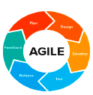

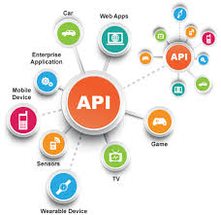
API Governance
API {1st} Programme
API Team
CIO
API Admin
Chief Architect
Data Dictionary
API Developer/Analyst
API Factory
APP Developer/Analyst
API Cookbook
Developers
Factory Manager
API Conventions
Architect
Tester
Methodology
Analytics
Technology
Notes:
API Governance Building Blocks
API Cookbook:
Describes how to build an API following the standards that the Integration Design Authority has set.
Data Dictionary:
Specifies the resources that are used in Solvay. This defines the path of your API.
API Conventions:
Includes naming conventions and error handling. The conventions are based on the REST
(Representational State Transfer) principles .

Slide 4
API Team
Position | Role | Comments
CIO | Sponsor | The CIO mandates the strategic change
Chief Architect | Sponsor | The Chief Architect is the evangelist for the API {1st} strategy.
Integration Architect | Design Authority | Responsible for the communication about Conventions, Cookbook, etc. within the organization
Solution Architect | Design Authority | Responsible for the exception handling and creation of new conventions / patterns.
Developer | API Team | Hands-on assistance to the Back-End teams for creating good API’s
CIO
API{1st}
strategy
Chief
Architect
Integration
Architect
API
Conventions
Design
Authority
Solution
Architect
API
Cookbook
Developer

Slide 5
Technical Artifacts
Data Dictionary
API Cookbook
API Conventions
Describes Specific Resources
Describes API Management
Describes API Specific conventions
API
Notes:
API Governance Building Blocks
API Cookbook:
Describes how to build an API following the standards that the Integration Design Authority has set.
Data Dictionary:
Specifies the resources that are used in Solvay. This defines the path of your API.
API Conventions:
Includes naming conventions and error handling. The conventions are based on the REST
(Representational State Transfer) principles .

Slide 6

Data Dictionary
Employees
absorbing Employee
preferences
bankAccount
contact
paymentPlans
accounts
Invoices
payment
contact
address
address
paymentPlanDetails
(measuringDevice)
type: <OneTimeCost>
bankAccount
orders
(orders)
person
lines
type: <serviceOrder>
payments
address
orderlines
location
agreements
lineDetails
address
organization
products
lineSubDetails
address
location
usage
legal Form
Notes:
Data Dictionary:
A place where business and/or technical terms and definitions are stored.
The data dictionary contains records that specify the data fields available in the API, including the display name and description of each field.
It specifies the resources that are used in Solvay. This defines the path of your API.

Slide 7
API Cookbook
Introduction
Structure and Flows
Proxy Request quadrant
Target Request Quadrant
Target Response Quadrant
Proxy Response Quadrant
Flows
Conditional Flows
Special Flows
Relations in SAM
The API product
The developer
The developer application
SAM Naming conventions
API policies
Products
Developer application
Test application
Products
Developer application
Test application
API Provider
Key-value maps
Policies
Security Policies
Traffic Management Policies
Mediation Policies
Extension Policies
Message Logging
Error Handling
Swagger / Specification
Notes:
API Cookbook (CB) describes how to build an API on the API management platform from SAP. We give information about best practices and the API flows and structures. Besides that, you will find all the information you will need to build a secure, RESTfull API in SAP API Management. This cookbook also features code examples for easy implementation.

Slide 8
API Conventions – End of API Governance
Introduction
Types of API’s
Security
North bound security
South bound security
Naming Conventions
Language
Host
Base Path
Path parameters versus Query parameters
API Naming
API Versioning
Caches
JSON
SAP specific naming conventions
HTTP Verbs
HTTP Headers
Content-Type versus Accept
Apikey
Authorization
CORS
Customer headers
Error handling
Http-status codes
Error messages
JSON versus SOAP
API specification
API testing
API logging
Notes:
API conventions describes Solvay specific choices on architecture and common practices that should be applied to build a strong and save API.

Slide 9
Data governance

Slide 10
API Lifecycle
API Ideation and Planning
Design
Observe
Mock
Try
Create/
configure
Deploy
Promote,
Deprecate,
Retire
Notes:
Ideation: Is a creative process whereby new and innovative ideas are generated and captured.
Design: This is the stage where requirements are translated into something tangible that can be built and delivered.
Analysis: This is the process of understanding all the business requirements
Mock and try: API mocking is a technique by which the methods/operations specified within an IDL are simulated by means of a mocking server.
Create/configure: Once an API mock is available or a service has been implemented and/or iterated an API can be created using API management capabilities, so different policies, such as authorization, rate limiting, monetization plans, and mediation, can be applied to it.
Deploy: Is a process by which a code artifact such as an API and/or service, is prepared and moved into a runtime environment for its execution and use.
Promote, deprecate, and retire
Observe: it is the ability of a system to externalize internal state data, namely logs (verbose and text-based representations of system events), traces (data representing a specific event that occurred within the application), and metrics.

Slide 11






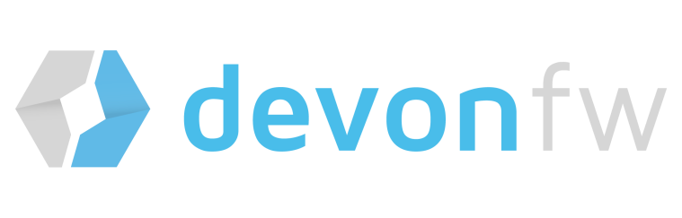


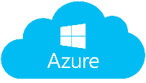

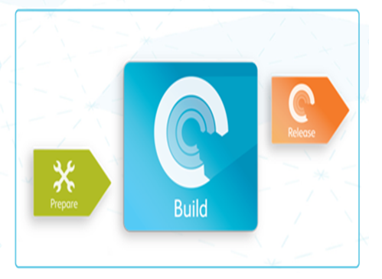
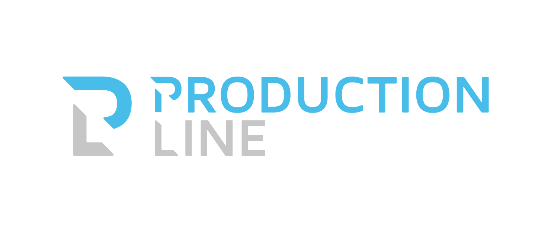


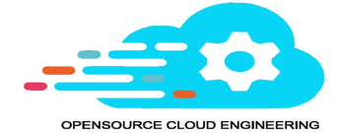

Frameworks & Accelerators-AD Center
Quick and effective induction
Cross Cutting Services
Competency and skill roadmap
Assessment
Guided introduction to Assembly Line
Translation factory
Project Monitoring framework
Other Shared Services
Profile and role specific trainings and certifications (Client developer, server side developer, Architect, UI specialist etc.)
Skilled teams
State of the art platforms
Expert design authority
Yard
A standard and proven platforms for industrialized software Development to deliver IT Solutions in a Digital world
Solution office
Development team working in a high speed industrialized “assembly line”
Business Analysts
Architects
Agile Coach
Efficient delivery model
Agile culture & processes
Productivity Accelerators
Preconfigured
Catalogue based estimation models
Capgemini Agile Framework
The complete lifecycle management and DevOps “toolkit”
Well defined governance
Notes:
Frameworks: Is similar to an application programming interface (API).It serves as a foundation for programming. It may also include code libraries, a compiler, and other programs used in the software development process.
Accelerators: It is a Methodology providing a holistic framework to guide customers through the process of setting up, building and delivering a successful API Program

Slide 12





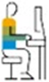
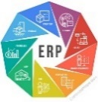
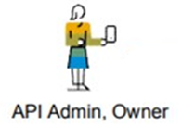
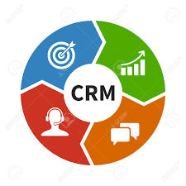
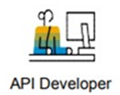


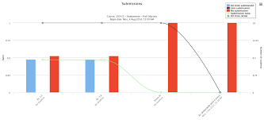


Conceptual Architecture
Client Applications
API Gateway
Backend
Systems
Automation Layer
Roles
Security
Cache
Traffic
Self Service
API Layer
Cloud
aaaaaaaaaaaaaaaaaaaaaaaaaaa
Micro-Services/Business Logic
Application Developer
kubernetes
Cluster
Docker container
Docker container
Docker container
Template Service
ERP
Orchestration
API Admin, Owner
Business Process Flow
Docker
CRM
API Developer
Devops
DynamoDB
Data Storage
RDS
S3Buckets
Elastic Search
Elasticache
Mainframe
Analytics
Notes:
The concept of reusability is widely used, in order to reduce cost, effort, and time of software development. Reusability also increases the productivity, maintainability, portability, and reliability of the software products, which it has been evaluated before in other software products.
Client: This is the people (or groups) that are the direct beneficiaries of a project or service. They are the people for whom the project is being undertaken. (Indirect beneficiaries are probably stakeholders.) These might also be called “customers”
API Gateway: Is the core of an API Management Solution. It acts as the single entryway into a system allowing multiple APIs or micro services. It provides the ability to design API specs, help provide enterprise-grade security, and manage APIs centrally.
API Layer: Building an infrastructure based on the API Layers that centralizes common architectural components of secure, developer-centric APIs can significantly simplify the process of implementing APIs that add real value to your business.
Analytics: API Analytics collects and calculates a wealth of information that flows through API proxies. You can visualize this data with graphs and charts in the Edge UI, or you can download the raw data for offline analysis.
Automation Layer: It is the technology by which a process or procedure is performed with minimal human assistance.
Roles: Jobs or positions that have a specific set of expectations and responsibility attached to them. Backend Systems: Is the code that runs on the server, that receives requests from the clients, and contains the logic to send the appropriate data back to the client. The back-end also includes the database, which will persistently store all of the data for the application.

Slide 13



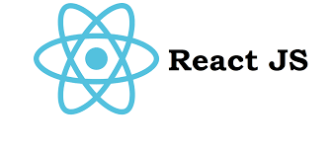
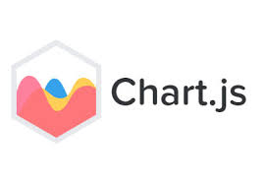

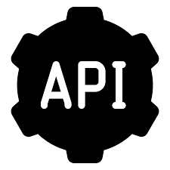

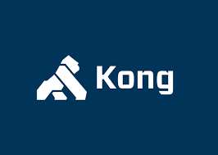
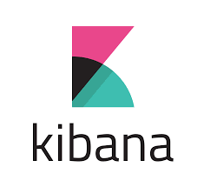
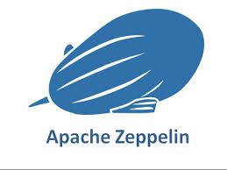


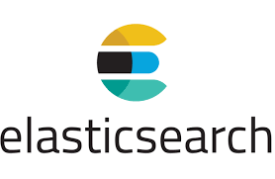


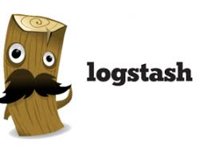


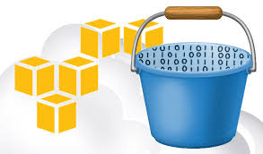
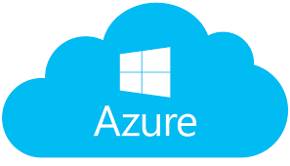

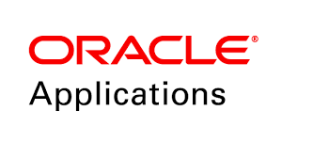
Technology View
Management Layer
UI Layer
API Layer
Analytics
Data Storage
Logs
Transactional / Operational Data
Meta / Reference Data
Data Processing
Data Access
Batch Processing
Real Time Data Processing
Amazon S3
Source Systems
Notes:
The Technology View of Developing and Deploying the API is as follows:
Management layer: Centralized solution control and monitoring, displaying the real-time status of every configured Solution object, and activating and deactivating solutions and single applications, including user-defined solutions.
UI layer: Is the way through which a user interacts with an application or a website.
API layer: A REST or Web services API layer offers a decoupled interface to data and/or functionality of one or more applications. It provides a common, language-agnostic way of interacting with an application.
Data storage: Is a term for how information is kept in a digital format that may be retrieved at a later time.
Data processing: Is the conversion of data into usable and desired form. This conversion or “processing” is carried out using a predefined sequence of operations either manually or automatically.
Data Access: It refers to a user's ability to access or retrieve data stored within a database or other repository.
Source system: Refers to any system or file that captures or holds data of interest.

Slide 14
Co-Op MyColleagueRecruit
Requirements
Solution Approach
Benefits
To deliver a custom user interface layer in the PaaS technology stack to enable front end web access for hiring managers and HR resourcing.
To deliver an integration layer in the technology stack to integrate with Taleo, the existing Oracle recruitment solution (which is used for Support Centre recruitment).
To deliver an interview scheduling component to support the colleague recruitment process.
To ensure colleagues responsible for supporting the new solution have a clear understanding of the solution integrations.
The delivery of a PaaS solution for Colleague Recruitment that delivers a custom User Interface (UI) and a supporting technology stack for integration with Taleo.
A user interface that comprises of JavaScript Extn Toolkt. Support for Alta UI.
An integration layer that comprises of Taleo Connect Server, Taleo Connect Client, Oracle Integration Cloud, Taleo Web services API, DBCS and Cronofy
Integration with the IGA tool Sailpoint
Technologies
Oracle Cloud Services, Spring Boot, Cronofy, Oracle JET, KnockOut JS, Taleo, Oracle Integration Cloud, Developer Cloud, REST API, SOAP and APIARY

Slide 15
Ladbrokes
Requirements
Solution Approach
Benefits
A mission-critical central shared service that will cater Business demands & regular business operational activities
Deliver a secure and robust API platform in compliance with IT strategy
Better agility and scalability to cater key festival and peak season demands
Process automation to drive towards well-structured DevOps Model
New systems require data access in real-time with high availability and reliability
Integration CoE Set-up & management
Integration and Solution Architecture
Design Authority & Integration Architecture Governance
API-led Microservice Architecture using TIBCO, java and cloud Technologies such as Spring boot framework, Kong API and AWS platform
Real-time data distribution framework using Apache Kafka
Agile Methodology & DevOps delivery Model
Reduced costs of business change function & maintenance by 20%-30% through ICC effectiveness and efficiency
Achieve 50% service reusability within projects - build on past successes & decrease duplication of integration
Improved ROI through creation and reuse of framework, building blocks, business rules & service assets
New API platform provided business agility and scalability
Ease in feature enhancements and maintainability
Technologies
Java 12, TIBO ActiveMatrix BusinessWorks, TIBCO EMS, Couchbase, Kibana, ElasticSearch, Kong, Spring Boot, Apache Kafka, Docker, & AWS (Amazon EC2, Amazon S3, Amazon Lamda, Amazon Elasticache, Amazon DynamoDB, Amazon RDS)

Slide 16
Canon
Requirements
Solution Approach
Benefits
A mission-critical central shared service that will cater Business demands & regular business operational activities
Deliver a secure and robust API platform in compliance with IT strategy
Better agility and scalability to cater key festival and peak season demands
Process automation to drive towards well-structured DevOps Model
New systems require data access in real-time with high availability and reliability
Integration SDL Tridion Set-up & management
Integration and Solution Architecture
Design Authority & Integration Architecture Governance
API-led Microservice Architecture using java and cloud Technologies such as Spring boot framework, Devon framework
Code coverage and quality using Sonar Qube.
Agile Methodology & DevOps delivery Model
Reduced costs of business change function & maintenance by 20%-30% through ICC effectiveness and efficiency
Achieve 50% service reusability within projects - build on past successes & decrease duplication of integration
Improved ROI through creation and reuse of framework, building blocks, business rules & service assets
New API platform provided business agility and scalability
Ease in feature enhancements and maintainability
Technologies
Java 8, Spring Boot, SDL Tridion (Content Management System), Devon Framework, SDL Web 8 Content Delivery Java API, Bit Bucket, Jenkins, Nexus Repository, Sonar Qube, JIIRA.

